Slide 1
Fourier Theory
Lecture 7
Fourier series
Even and odd functions
Half range expansions (next time)

Slide 2
Fourier Theory
Important to the engineers and physicists because Fourier series allow the solutions of Ordinary Differential Equations (ODEs) in connection with forced oscillations and the approximation of periodic functions
Used in courses e.g Mechanical vibrations (civil) Beams and plates (civil)

Slide 3
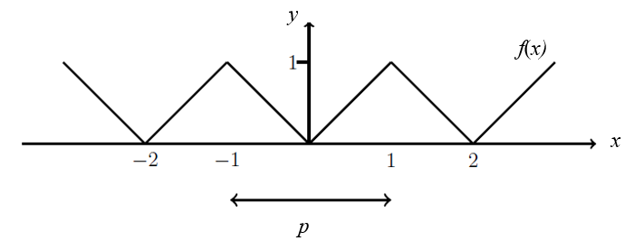
Fourier Theory
Fourier series are infinite series designed to represent general periodic functions in terms of cosines and sines
Periodic function:
A function f(x) is called periodic with period p > 0 if: f(x) = f(x + p) for all x
Ex.
J. Schmiegel: Lecture notes

Slide 4
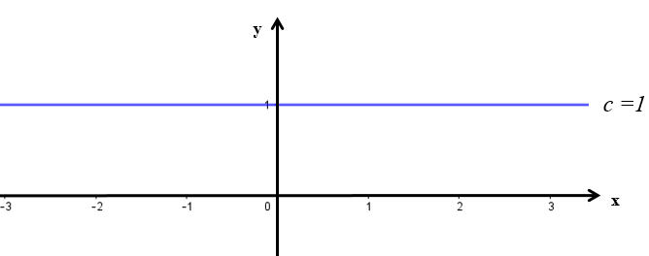
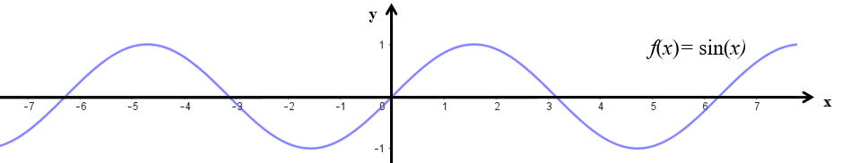
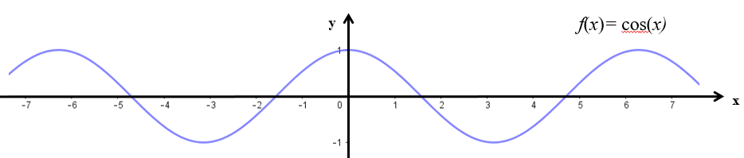




Periodic functions
Ex.: periodic function: f(x) = f(x + p) period p > 0, for all x
f(x) = c = constant = f(x + p) for any period p
f(x) = sin x = sin(x + p) = f(x+p), p = 2π, 4π, . . .
$$−π$$
$$π$$
f(x) = cos x = cos(x + p) = f(x+p), p = 2π, 4π . . .
$$−π$$
$$π$$

Slide 5
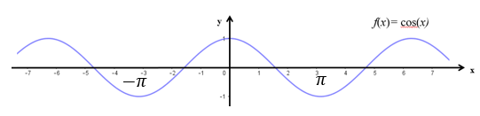



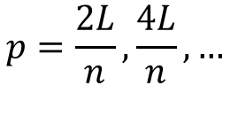
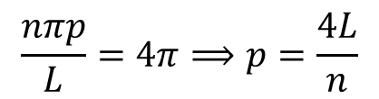

Periodic functions
Ex.: f(x) = f(x + p) period p > 0, for all x
f(x) = f(x + p)
$$p=\frac{2L}{n},\frac{4L}{n},…$$
$$n∈ℕ$$
$$\frac{nπp}{L}=2π⟹p=\frac{2L}{n}$$
$$\frac{nπp}{L}=4π⟹p=\frac{4L}{n}$$

Slide 6

Periodic functions
We are often interested in approximating a given periodic function f(x) with period p = 2L as a weighted sum of
e.g.
if f(x) is discontinuous: approximation by continuous functions
if f(x) is complicated: approximation by a sum of simple functions
to solve diﬀerential equations
for spectral analysis

Slide 7
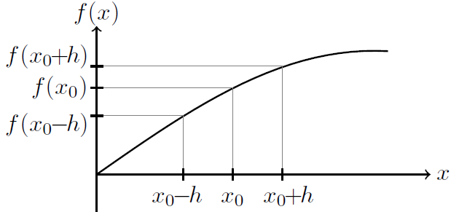

Continuous function
A function is continuous if the function does not have any abrupt changes in value, known as discontinuities.
J. Schmiegel: Lecture notes

Slide 8


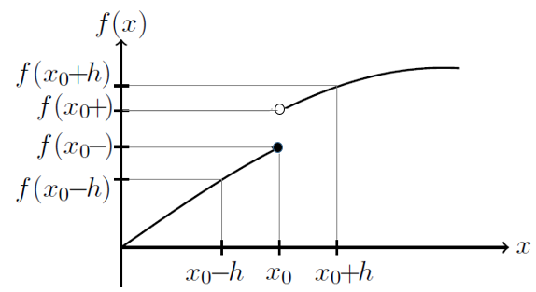
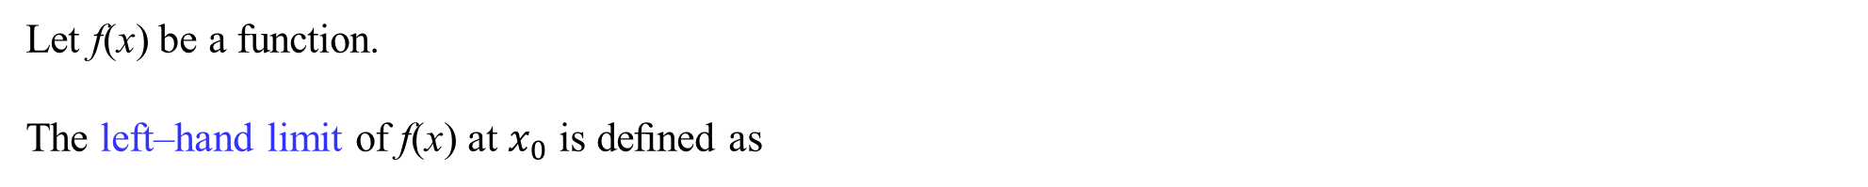
Left–hand limit and right–hand limit
Let f(x) be a function.
The left–hand limit of f(x) at $x_{0}$ is deﬁned as
The right–hand limit of f(x) at $x_{0}$ is deﬁned as
J. Schmiegel: Lecture notes

Slide 9
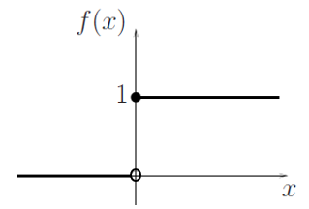
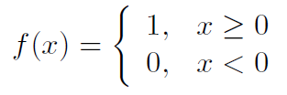




Left–hand limit and right–hand limit
Ex.:
J. Schmiegel: Lecture notes
The left–hand limit of f(x) at $0$ is:
The right–hand limit of f(x) at $0$ is:

Slide 10

Differentiable function
A function is differentiable at a point $x_{0}$ if
J. Schmiegel: Lecture notes

Slide 11


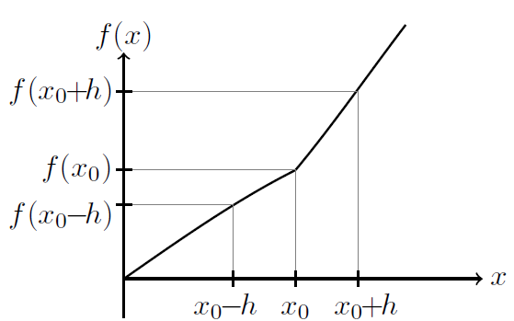
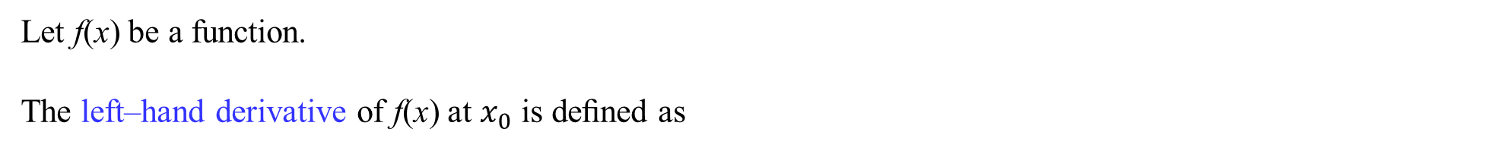
Left–hand derivative and right–hand derivative
Let f(x) be a function.
The left–hand derivative of f(x) at $x_{0}$ is deﬁned as
The right–hand derivative of f(x) at $x_{0}$ is deﬁned as
J. Schmiegel: Lecture notes

Slide 12
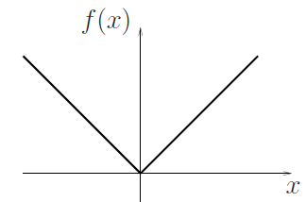





Left–hand derivative and right–hand derivative
Ex.:
$$f\left(x\right)=\left|x\right|$$
J. Schmiegel: Lecture notes
The left–hand dirivative of f(x) at $0$ is:
The right–hand dirivative of f(x) at $0$ is:

Slide 13
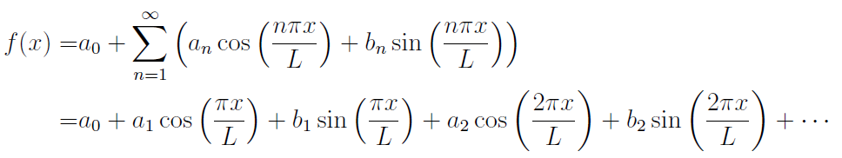



Fourier series representation
Let f(x) be a function with period p = 2L that is piecewise continuous in [−L, L] and
assume that the left–hand derivative and the right–hand derivative exist in [−L, L].
The Fourier series representation of f(x) at points x where f(x) is continuous
and at points $x_{0}$ where f(x) is not continuous:
$$f\left(x_{0}\right)=$$

Slide 14
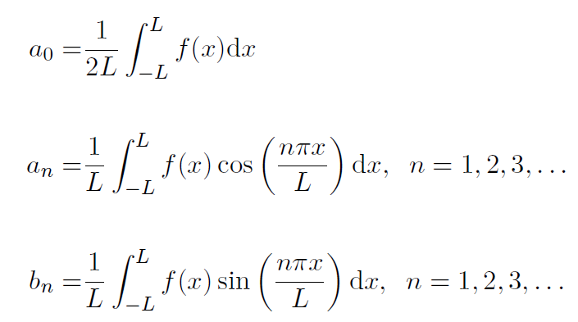
Fourier coeﬃcients
The Fourier coeﬃcients is given by the Euler formulas:

Slide 15
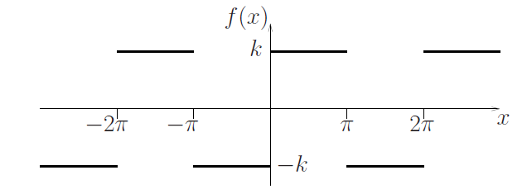
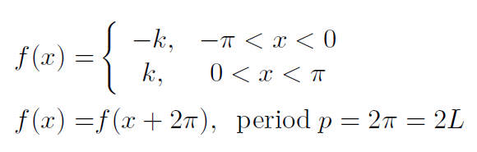
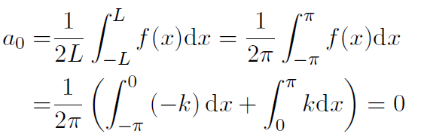
Fourier coeﬃcients
Ex.:
Given the periodic rectangular wave deﬁned by:
J. Schmiegel: Lecture notes

Slide 16
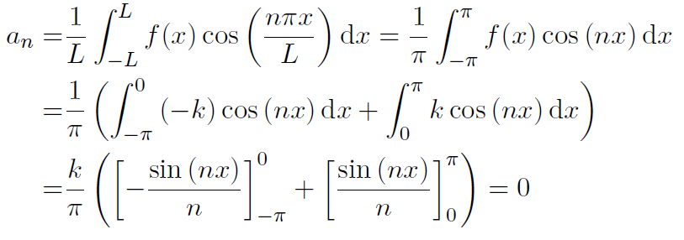
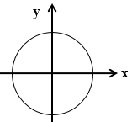
Fourier coeﬃcients
Ex. cont. the periodic rectangular wave

Slide 17
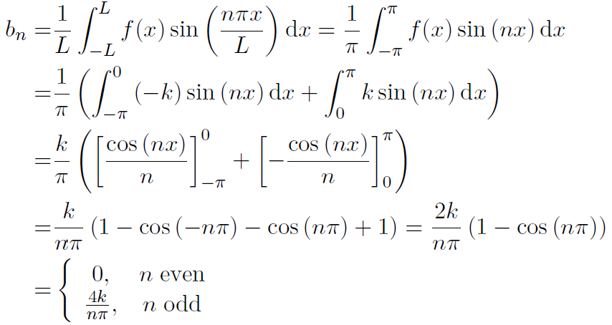


Fourier coeﬃcients
Ex. cont. the periodic rectangular wave
$$\cos\left(x\right)=cos⁡(−x)$$
i.e.

Slide 18
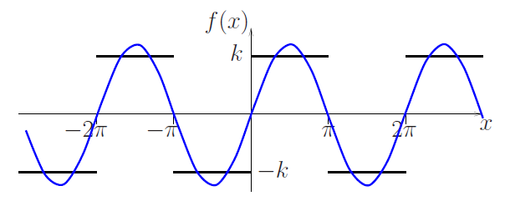
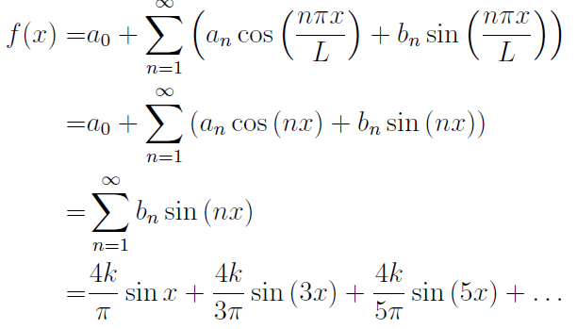
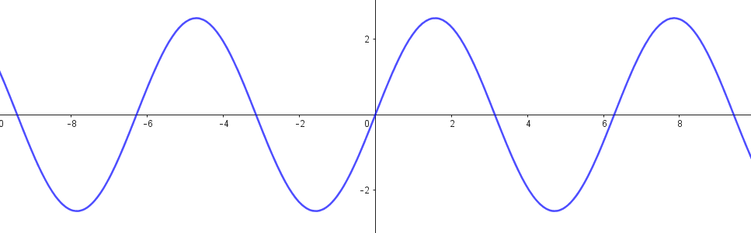
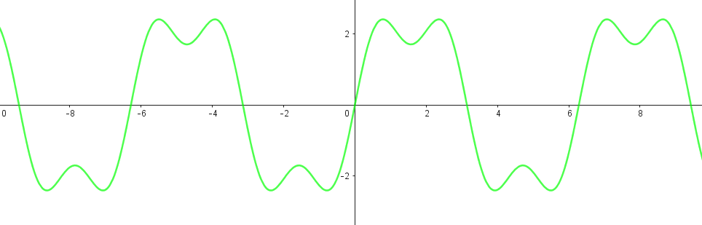
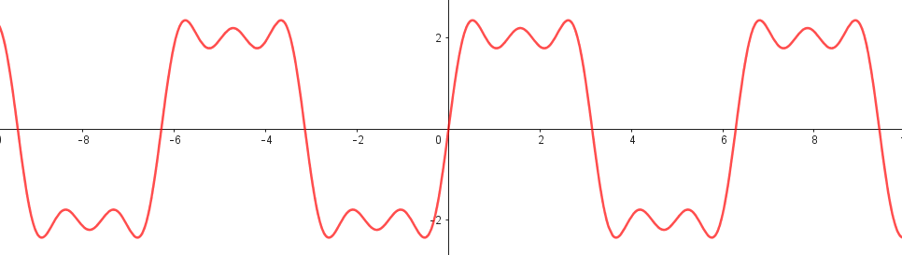


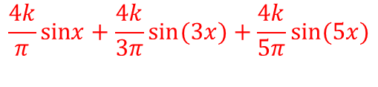
Fourier coeﬃcients
Ex. cont. the periodic rectangular wave
J. Schmiegel: Lecture notes
$$\frac{4k}{π}sinx$$
$$\frac{4k}{π}sinx+\frac{4k}{3π}sin(3x)$$
$$\frac{4k}{π}sinx+\frac{4k}{3π}sin(3x)+\frac{4k}{5π}sin(5x)$$

Slide 19
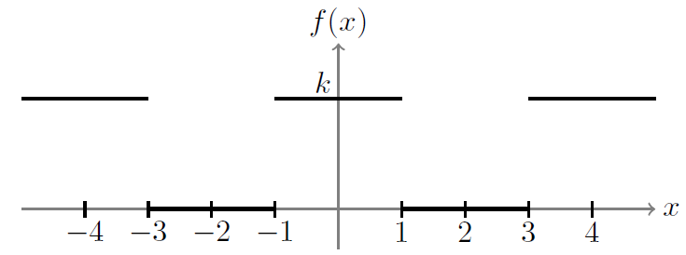
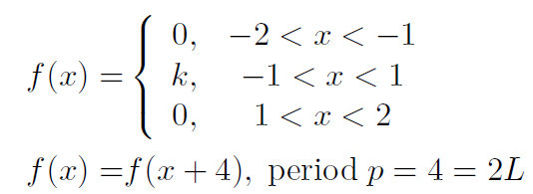
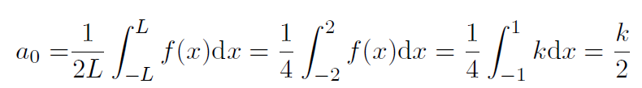
Fourier coeﬃcients
Ex.:
Given a symmetric periodic rectangular wave deﬁned by:
J. Schmiegel: Lecture notes

Slide 20
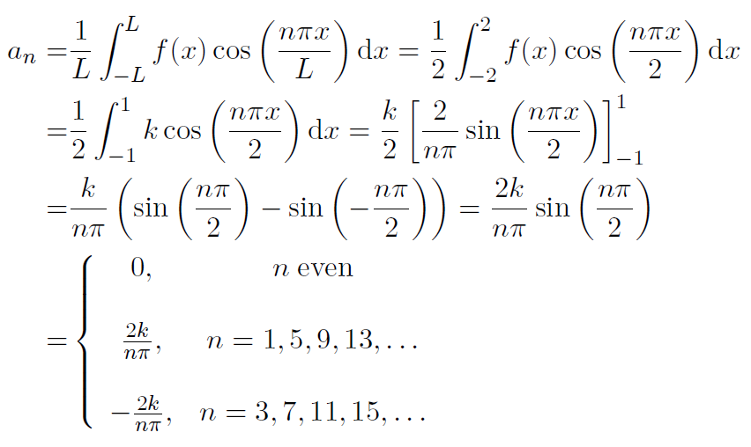

Fourier coeﬃcients
Ex. cont. the symmetric periodic rectangular wave
$$\sin\left(x\right)=−sin⁡(−x)$$

Slide 21
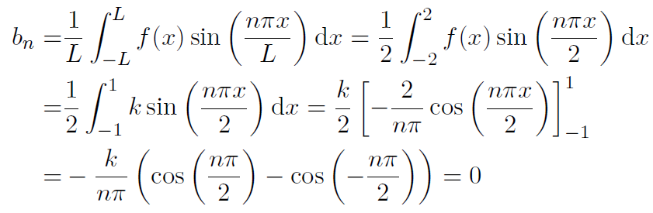

Fourier coeﬃcients
Ex. cont. the symmetric periodic rectangular wave
$$\cos\left(x\right)=cos⁡(−x)$$

Slide 22
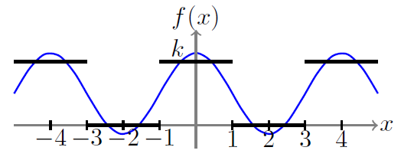
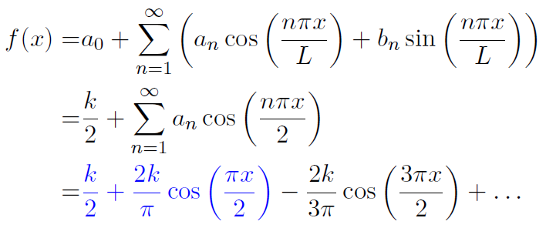
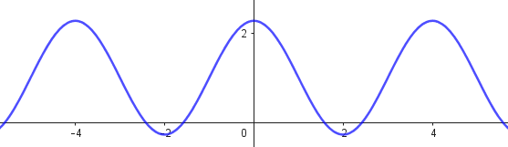
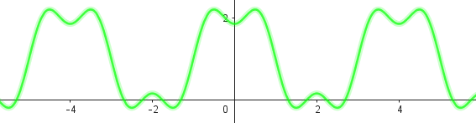
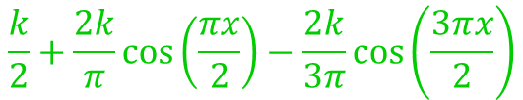
Fourier coeﬃcients
Ex. cont. the symmetric periodic rectangular wave
J. Schmiegel: Lecture notes
$$\frac{k}{2}+\frac{2k}{π}\cos\left(\frac{πx}{2}\right)−\frac{2k}{3π}\cos\left(\frac{3πx}{2}\right)$$

Slide 23
Fourier coeﬃcients
A periodic rectangular wave: (only sine functions)
J. Schmiegel: Lecture notes
A symmetric periodic rectangular wave: (only cosine functions)
J. Schmiegel: Lecture notes

Slide 24
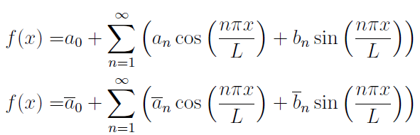

Uniqueness
The Fourier coeﬃcients of a periodic function f with period p = 2L are unique
i.e.
if
then
$a_{0}={\overline{a}}_{0}$, $a_{1}={\overline{a}}_{1}$, $b_{1}={\overline{b}}_{1}$, …

Slide 25


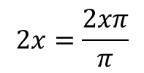







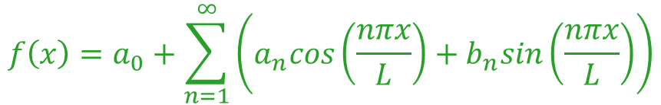
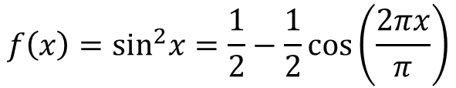
Uniqueness
Ex.: Find the Fourier coeﬃcients of a periodic function f with period p = 2L
$$f\left(x\right)=a_{0}+\sum_{n=1}^{∞}{\left(a_{n}cos\left(\frac{nπx}{L}\right)+b_{n}sin\left(\frac{nπx}{L}\right)\right)}$$
$$a_{0}=1$$
$$L=7$$
$$a_{11}=1$$
$$b_{3}=1$$
all the other coefficients are zero
Look at the argument:
$$2x=\frac{2xπ}{π}$$
$$a_{0}=\frac{1}{2}$$
$$a_{2}=−\frac{1}{2}$$
$$L=π$$
$$f\left(x\right)=\sin^{2}x=\frac{1}{2}−\frac{1}{2}cos\left(\frac{2πx}{π}\right)$$
all the other coefficients are zero

Slide 26
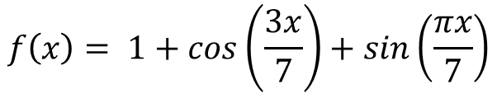




Uniqueness
Ex. cont.: Find the Fourier coeﬃcients of a periodic function f with period p = 2L
$$f\left(x\right)=a_{0}+\sum_{n=1}^{∞}{\left(a_{n}cos\left(\frac{nπx}{L}\right)+b_{n}sin\left(\frac{nπx}{L}\right)\right)}$$
*
$$f\left(x\right)= 1+sin\left(\frac{3πx}{7}\right)+5cos\left(\frac{3πx}{14}\right)= 1+sin\left(\frac{2∙3πx}{2∙7}\right)+5cos\left(\frac{3πx}{14}\right)= 1+sin\left(\frac{6πx}{14}\right)+5cos\left(\frac{3πx}{14}\right)$$
$$L=14$$
$$a_{0}=1$$
$$a_{3}=5$$
$$b_{6}=1$$
all the other coefficients are zero
$$f\left(x\right)= 1+cos\left(\frac{3x}{7}\right)+sin\left(\frac{πx}{7}\right)$$
is not a periodic compared to *

Slide 27
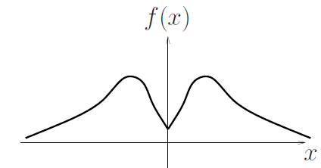
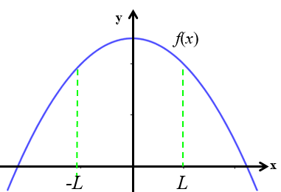
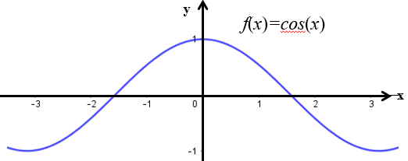
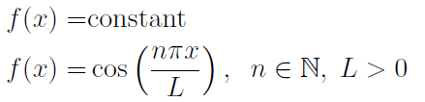
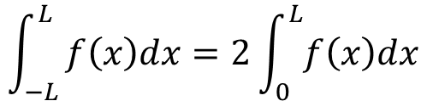

Even and odd functions
Even function: A function f(x) is called an even function if
$f\left(x\right)=f(−x)$ for all x
J. Schmiegel: Lecture notes
Other examples of even functions:
$$\int_{−L}^{L}{f\left(x\right)dx=2\int_{0}^{L}{f\left(x\right)dx}}$$

Slide 28
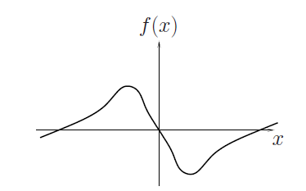





Even and odd functions
Odd function: A function f(x) is called an odd function if
$f\left(x\right)=−f(−x)$ for all x
J. Schmiegel: Lecture notes
Other examples of odd functions:
$$\int_{−L}^{L}{f\left(x\right)dx=0}$$

Slide 29


Rules for even and odd functions
Let E(x) be an even function and O(x) be an odd function then:
$$E\left(x\right)∙E\left(x\right)=even$$
$$O\left(x\right)∙O\left(x\right)=even$$
$$E\left(x\right)∙O\left(x\right)=odd$$
Proof:
$$E\left(−x\right)∙E\left(−x\right)=E\left(x\right)∙E\left(x\right)$$
$$O\left(−x\right)∙O\left(−x\right)=−O\left(x\right)∙(−O\left(x)\right)=O\left(x\right)∙O\left(x\right)$$
$$E\left(−x\right)∙O\left(−x\right)=E\left(x\right)∙(−O\left(x)\right)=−E\left(x\right)∙O\left(x\right)$$

Slide 30



Fourier cosine series
Given an even and periodic function f(x) with period p = 2L
The Fourier series of f(x) will then only contain even functions
$$f\left(x\right)=a_{0}+\sum_{n=1}^{∞}{a_{n}cos\left(\frac{nπx}{L}\right)}$$
Fourier cosine series:
$$a_{0}=\frac{1}{2L}\int_{−L}^{L}{f\left(x\right)dx}=2\frac{1}{2L}\int_{0}^{L}{f\left(x\right)dx=\frac{1}{L}\int_{0}^{L}{f\left(x\right)dx}}$$
The Fourier coeﬃcients are:
$$a_{n}=\frac{1}{L}\int_{−L}^{L}{f\left(x\right)cos\left(\frac{nπx}{L}\right)dx}=\frac{2}{L}\int_{0}^{L}{f\left(x\right)cos\left(\frac{nπx}{L}\right)dx}$$
$$b_{n}=\frac{1}{L}\int_{−L}^{L}{f\left(x\right)sin\left(\frac{nπx}{L}\right)dx=0}$$

Slide 31




Fourier sine series
Given an odd and periodic function f(x) with period p = 2L
The Fourier series of f(x) will then only contain odd functions
$$f\left(x\right)=\sum_{n=1}^{∞}{b_{n}sin\left(\frac{nπx}{L}\right)}$$
Fourier sine series:
$$a_{0}=\frac{1}{2L}\int_{−L}^{L}{f\left(x\right)dx}=0$$
The Fourier coeﬃcients are:
$$a_{n}=\frac{1}{L}\int_{−L}^{L}{f\left(x\right)cos\left(\frac{nπx}{L}\right)dx}=0$$
$$b_{n}=\frac{1}{L}\int_{−L}^{L}{f\left(x\right)sin\left(\frac{nπx}{L}\right)dx=2\frac{1}{L}\int_{0}^{L}{f\left(x\right)sin\left(\frac{nπx}{L}\right)dx}}$$

Slide 32






Even and odd functions
Ex.:
Let
$$f\left(x\right)=x, −π<x<π$$
$$f\left(x\right)=f\left(x+p\right), p=2π=2L$$
J. Schmiegel: Lecture notes
$$As f\left(x\right)=x=−f\left(−x\right) then f\left(x\right) is an odd function$$
The coeﬃcients of the Fourier sine series are:

Slide 33









Even and odd functions
Ex. cont:
Let
$$f\left(x\right)=x, −π<x<π$$
$$f\left(x\right)=f\left(x+p\right), p=2π=2L$$
J. Schmiegel: Lecture notes
The Fourier sine series of $f\left(x\right)$ are:
$$2sinx$$
$$2sinx−sin⁡(2x)$$
$$=2sinx−\sin\left(2x\right)+\frac{2}{3}\sin\left(3x\right)+…$$
$$2sinx−\sin\left(2x\right)+\frac{2}{3}sin⁡(3x)$$

Slide 34


We are doing exercises from lecture notes 7

Slide 35

Useful formulas
Integration by parts:
The powers of trigonometric functions:
$$\cos^{2}t= \frac{1}{2}(1+cos2t)$$
$$\sin^{2}t= \frac{1}{2}(1−cos2t)$$

